Slide 1
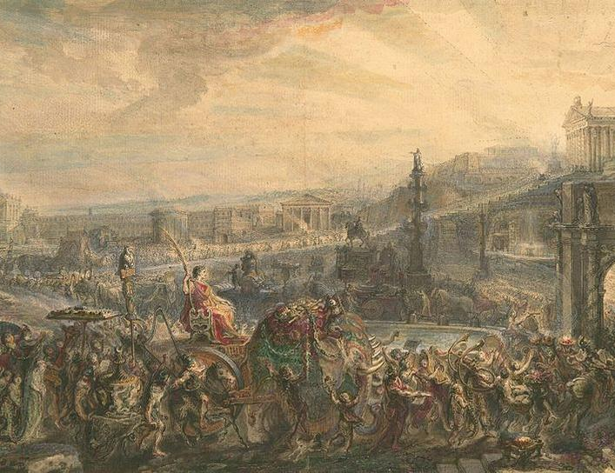
Key People
LEARNING INTENTIONS:
- Research key people for Unit 1
Week 5 Lesson 2
Ms Barrie

